Slide 1
From Faucet Flows a Torrent!
NoviFlow NoviWare for Tofino: Faucet on a 6.5 Tbps Programmable Fabric
May 18, 2018

Slide 2



ABOUT NOVIFLOW
World’s leading provider of SDN Network Operating Systems
and solutions for programmable match-action data planes
FOUNDED
2012
Business Model
Software Licensing
Systems Sales
Founding Member of the FAUCET Foundation!
FOCUS
SDN
Cybersecurity
PRODUCTS
NOS
Whitebox switches
Controller Applications
ARCHITECTURES
NPU
Tofino
Production deployments worldwide
by global network operators,
enterprises and government agencies
One of 10 Canadian Scale-Up companies in 2016

Slide 3
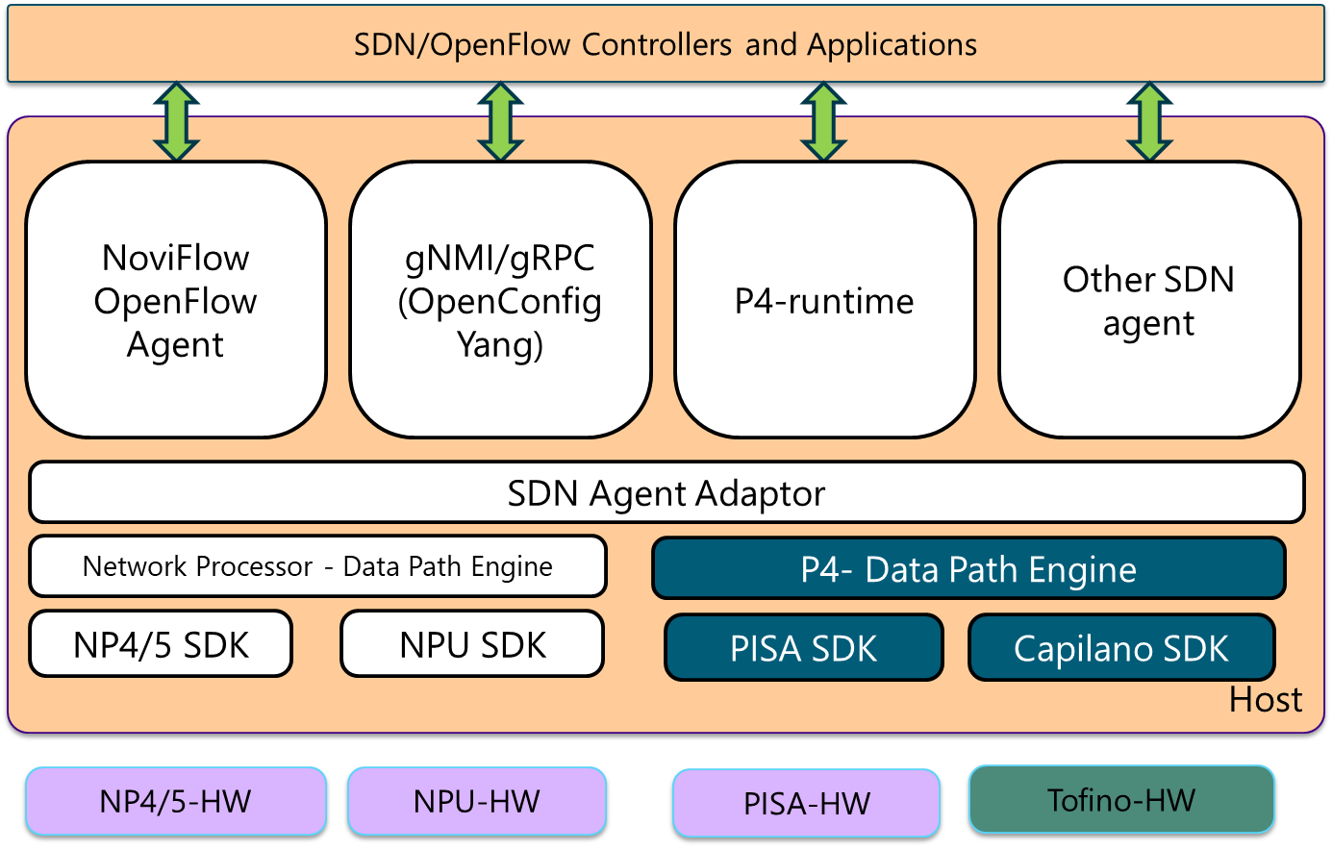
NoviWare OpenFlow NOS
Engineered for high performance and programmability as needed by intensive, leading-edge Networking and NFV applications
“Switch Chip” support,
Mellanox Network Processor
Barefoot/Tofino
Hardware abstraction enables easy porting to new hardware platforms
Open API - Pure play OpenFlow implementation
Broadest implementation of OpenFlow 1.3/1.4/1.5 specifications
Extensive OA&M capabilites
Short time to market for new/custom features and functions
Also custom hardware possible, e.g., port configurations
(soon)
(TBD)

Slide 4
NoviWare OA&M features and OpenFlow Enhancements
Extended set of CLI features:
Set/Show configuration for switch, controllers, ports, flow tables, users, meters, adding/removing flow entries, status and stats
Security features;
TACACS+/RADIUS for AAA services
ACL (allowed IP addresses) on management ports
CLI Log with accessing IP address for configuration change traceability
Zero-Touch Provisioning (ZTP)
gRPC remote access of CLI commands
NoviSwitch administrative features:
CLI Log export to external Log server
Remote installation, update and roll-back of software revisions
Remote power on/off and reboot
Switch configuration export/import in binary and text formats
Automatic periodic switch configuration uploads to an external server for configuration management
VLAN on management ports
OF-CONFIG 1.1.1/1.2
SNMP traps for hardware fault alarms
OpenFlow Experimenter Features and Functions
Tunneling
Ethernet/MPLS/IP Payload Matching
Swap_Fields
BFD Failover
Traffic Manager / Shaping / H-QoS
Metering (1 million)
Time Stamping (HW+SW)
Load Balancer (consistent hashing)
In-Band Controller
…
Notes:
The two top level messages:
The NoviWare NOS brings carrier-grade SDN technology to the Tofino’s Programmable Match-Action Pipeline
Based on an open-standard - OpenFlow
OpenFlow applications and controllers implemented to the 1.5 specification will run on Tofino
Smaller table size limits compared to NP-5
Supporting Messaging:
NoviWare provides a “Real” OpenFlow 1.5 complaint NOS
NoviWare provides key extension to support tunneling protocols, time stamping,, consistent hashing and others
Rapidly enhancing NoviWare to meet a client’s need is a key aspect of our Business Model
NoviWare provides market-leading Operations and Management (O&M) functionality
NoviWare leverages the P4 SDK environment to accelerate innovation
NoviWare supports multiple NPU architectures
This provides a board range of advances features such as H-QOS

Slide 5

NoviWare NOS Delivers Programmable Match-Action Pipeline
Complete flexibility / millions of flow rules/ Extendible Architecture
Define tables and pipeline architecture on-the-go
Assign the size/match fields/actions wanted to each table
Match/actions on both packets headers & packet payload
Optimized for packet switching
real-time filtering, load balancing and monitoring w/instant mitigation actions
0 | 0 | 0 | 0 | 0 | 0 | 0 | 0 | 0 | 0 | 1 | 1 | 1 | 1 | 1 | 1 | 1 | 1 | 1 | 1 | 2 | 2 | 2 | 2 | 2 | 2 | 2 | 2 | 2 | 2 | 3 | 3 | 3 | 3 | 3 | 3 | 3 | 3 | 3 | 3 | 4 | 4 | 4 | 4 | 4 | 4 | 4 | 4 | 4 | 4 | 5 | 5 | 5 | 5 | 5 | 5 | 5 | 5 | 5 | 5 | 6 | 6 | 6 | 6 | 6 | 6 | 6 | 6 | 6 | 6 | 7 | 7 | 7 | 7
0 | 1 | 2 | 3 | 4 | 5 | 6 | 7 | 8 | 9 | 0 | 1 | 2 | 3 | 4 | 5 | 6 | 7 | 8 | 9 | 0 | 1 | 2 | 3 | 4 | 5 | 6 | 7 | 8 | 9 | 0 | 1 | 2 | 3 | 4 | 5 | 6 | 7 | 8 | 9 | 0 | 1 | 2 | 3 | 4 | 5 | 6 | 7 | 8 | 9 | 0 | 1 | 2 | 3 | 4 | 5 | 6 | 7 | 8 | 9 | 0 | 1 | 2 | 3 | 4 | 5 | 6 | 7 | 8 | 9 | 0 | 1 | 2 | 3
Ethernet |  |  |  |  |  |  |  |  |  |  |  |  |  | IPv4 |  |  |  |  |  |  |  |  |  |  |  |  |  |  |  |  |  |  |  | UDP |  |  |  |  |  |  |  | GTP |  |  |  |  |  |  |  |  |  |  |  | IPv4 |  |  |  |  |  |  |  |  |  |  |  | src-ip |  |  |  | dst-ip
…
Example: 1 Tbps data stream

Slide 6
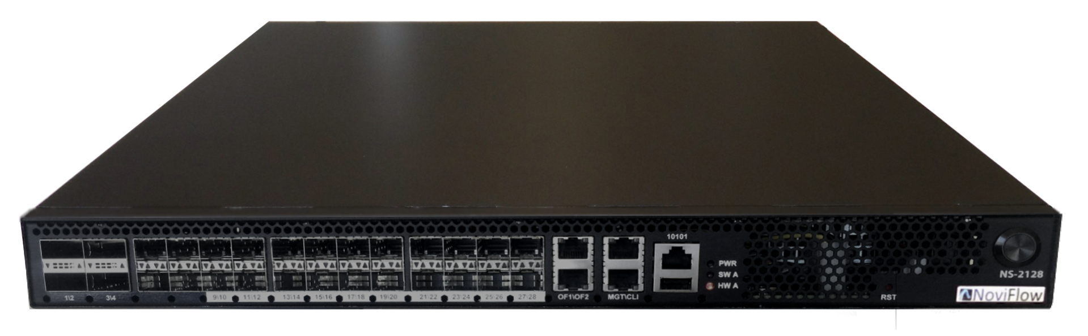

NoviFlow And Faucet
Faucet
NoviFlow products deliver everything needed by Faucet:
Multi-table OpenFlow pipeline that is fully programmable to support Faucet + your own innovations
Line-rate Support for millions of flows
Extensive capabilities to optimize applications
Community support at www.inside-openflow.com
NoviWare is the Ideal OpenFlow data plane for use with FAUCET!
Control Plane
Forwarding Plane

Slide 7
Faucet on inside-openflow.com
plus…
The tools, tutorials and training you need to get started with OpenFlow and Faucet

Slide 8


TWO CRITICAL CONCEPTS
6.5
Tbps
The Big Event
The only Multi-Terabit “real” SDN NOS started shipping last month.
The Big Idea SDN Technology to enable Scaling and Acceleration of a Faucet
Fast & Secure
2018

Slide 9

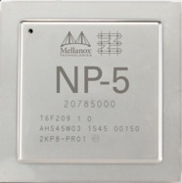
NoviWare® Programmable Pipeline Silicon
NoviWare was made for Programmable Silicon Substrates!
Since 2013
Global installed base of Faucet compatible
OpenFlow switches
Now
Supporting Barefoot Tofino white Boxes offering up to 6.5 Tbps!
Coming
Integration of P4 Runtime
Mature OF Implementation
Leading Edge of P4 Integration

Slide 10


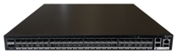
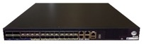
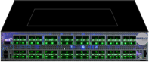
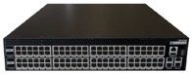
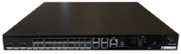
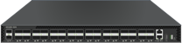
Use Case: Ethernet Access, Aggregation and Core
Broadband Access (BNG/EPC), Gateways, WAN Edge/Core
ACCESS
AGGREGATION
CORE
NS-21100
48x1G
NoviSwitch 2150
2x40G
24x10G
NoviSwitch 2128
4x40G
64x100G
WB-5164
NS-21100
96x1G
NoviSwitch 21100
4x40G
20x10G
NoviSwitch 2122
2x100G
32x100G
WB-5132
10

Slide 11
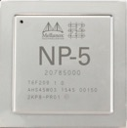
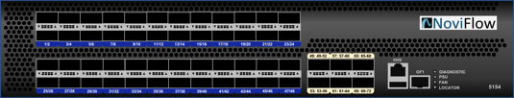
NoviSwitch® NOS/Whitebox Switch Portfolio
High performance programmable Network Operating System for COTS bare-metal switches
Multi-functional, match action programmable pipelines
Multiple open northbound APIs for application integration
Continuous innovation
NoviSwitch 2000 Product Line
White Box 5000 Product Line

Slide 13
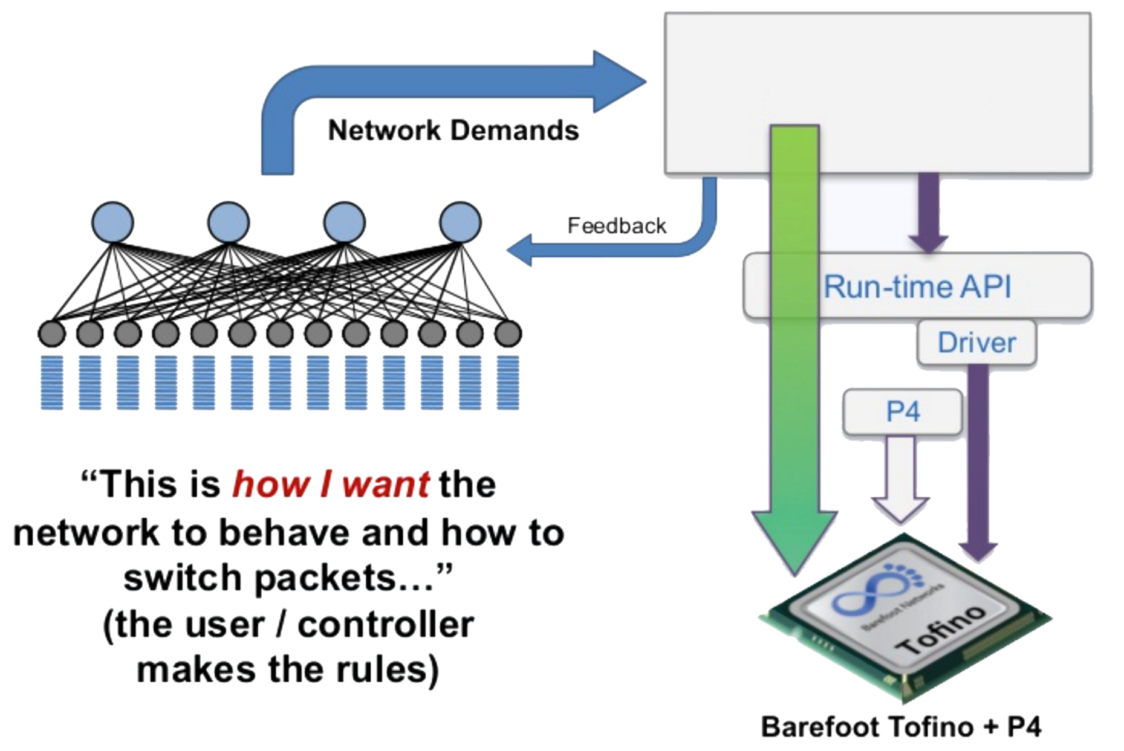


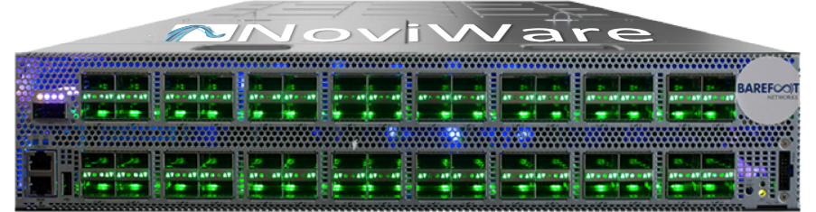
NoviFlow and Barefoot
Barefoot Tofino complements Mellanox NP switch chips
Mellanox
High programmability
Lower throughput
Barefoot Networks
High throughput
Lower programmability

Slide 14

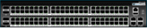
NoviSwitch® - Ready to Deploy
 | NS-2116 | NS-2122 | NS-2128 | NS-2150 | NS-21100 | WB-5164 | WB-5132
Switching Capacity (Gbps) * | 160 | 400 | 400 | 128 | 256 | 6,400 | 3,200
Forwarding Capacity (Mpps) * | 240 | 360 | 360 | 190 | 360 | 4,000 | 2,000
Ports ** | 16xSFP/SFP+ | 20xSFP/SFP+ & 2xQSFP28 | 20xSFP/SFP+ & 4xSFP+ & 4xQSFP+ | 48xSFP & 2xQSFP+ | 96x10/100/ 1000BASE-T & 4xQSFP+ | 64xQSFP28 | 32xQSFP28
Flow Entries (TCAM) * | 15K | 1M |  | 16K/1M |  | 100K***
Flow Entries (DRAM) * | 6M |  |  |  |  | 2.6M***
Flow Modifications/Sec* | 3,200 | 40K |  |  |  | TBD
Group Table Entries | 10K |  |  |  |  | TBD
OpenFlow Meters | 1M |  |  |  |  | TBD
Availability | Q2’16 |  | Q2’15 | Q1’17 |  | ~ Q1’18 | TBD
*) Disclaimer: Performance ratings have been obtained under specific test conditions and reflect the maximum performance of NoviSwitch products as measured by those tests. Any difference in test and configuration will affect actual performance.
**) Fanout options:
QSFP fanout to 4x10GE
***) Assuming 32bits match fields (eg. IPv4 address)

Slide 15



Summary
NoviWare® Network Operating System
3
 | Carrier-grade NOS architected specifically to enable programmable match-action pipelines Leverages high performance whiteboxes running network processors and Tofino chips Multiple open northbound APIs for application integration Three annual software releases per year for continuous innovation
1
NoviSwitch 2000®
Network Processor line:
EZChip/Mellanox - NP5 Chipset
High throughput (100Gbps to 400Gbps)
Augmented with external TCAM/DRAM for very large flow counts (up to 7 million)
H-QoS
NoviSwitch 5000®
Tofino Line:
Barefoot/Tofino Chipset
Support for multiple whiteboxes (eg. EdgeCore)
Very high throughput (6.5Tbps)
TCAM/DRAM for large flow counts (up to 300K)
2

